Slide 1
Computational Biology Coffee chats!
info. slides & links!

Slide 2
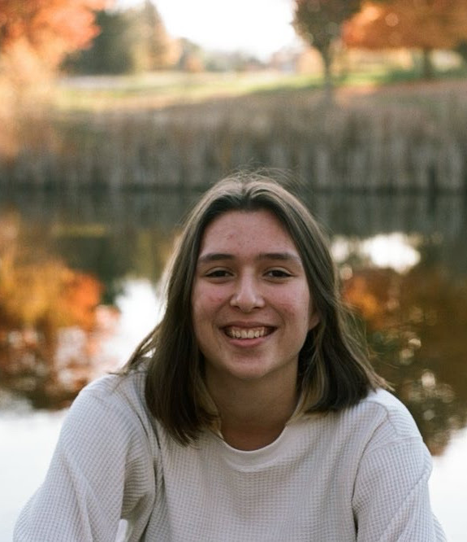
Mia Sanborn
Major + graduation year: Computational Biology, 2027
Hi, I'm Mia! Outside of my classes I'm also involved in the undergraduate honors thesis, TA-ing, and Ultimate Frisbee! Last summer I completed an internship at Broad Institute where I worked on improving an SVM for classifying mutations in tumor DNA. Feel free to schedule a chat to talk about any of this or anything else, I'm a big yapper : )
Feel free to contact me here if you have any questions (even if you don’t schedule a coffee chat)!
Email: msanborn@andrew.cmu.edu
Instagram: mia_zsanborn
Link to schedule a meeting with me!

Slide 3
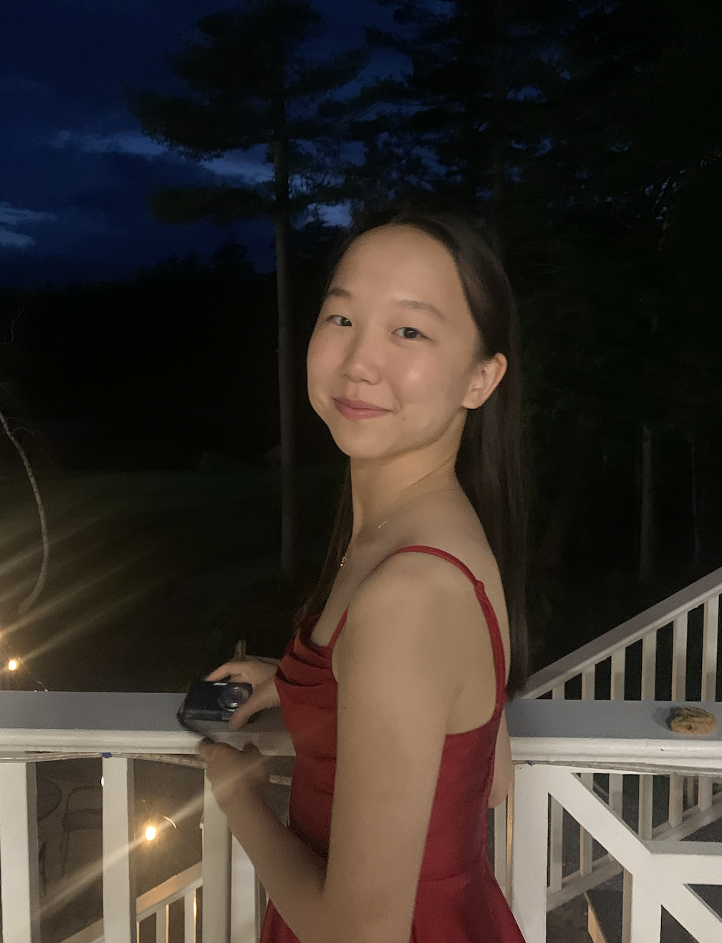
Emma Li
Major + graduation year: Neuroscience and Computational Biology Additional Major, 2028
Hi! I’m a junior studying neuroscience and computational biology! I do compbio research and I am the co-president of CBUS and president of the Chinese Dance Club at CMU. Schedule a chat with me if you’re interested in any of these things!
Feel free to contact me here if you have any questions (even if you don’t schedule a coffee chat)!
email: emmali@andrew.cmu.edu
instagram: @emjingli
Link to schedule a meeting with me!

Slide 4
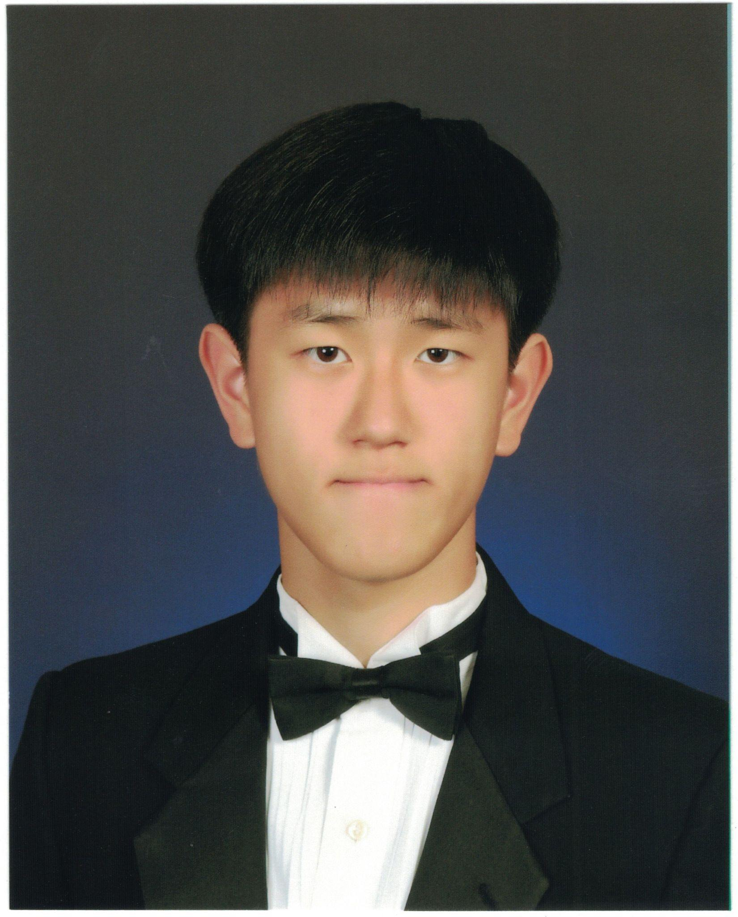
Tyler Yang
Major + graduation year: Computer Science, 2028
Hello, I’m Tyler! I am a junior in SCS. I currently am TAing for 15-210 and I have also done computational chemistry and AI for Science research at CMU via SURA. In my spare time I am part of Futsal Club. Feel free to contact me about anything, and feel free to schedule a coffee chat!
Email: tylery@andrew.cmu.edu. Please email to schedule a coffee chat!

Slide 5
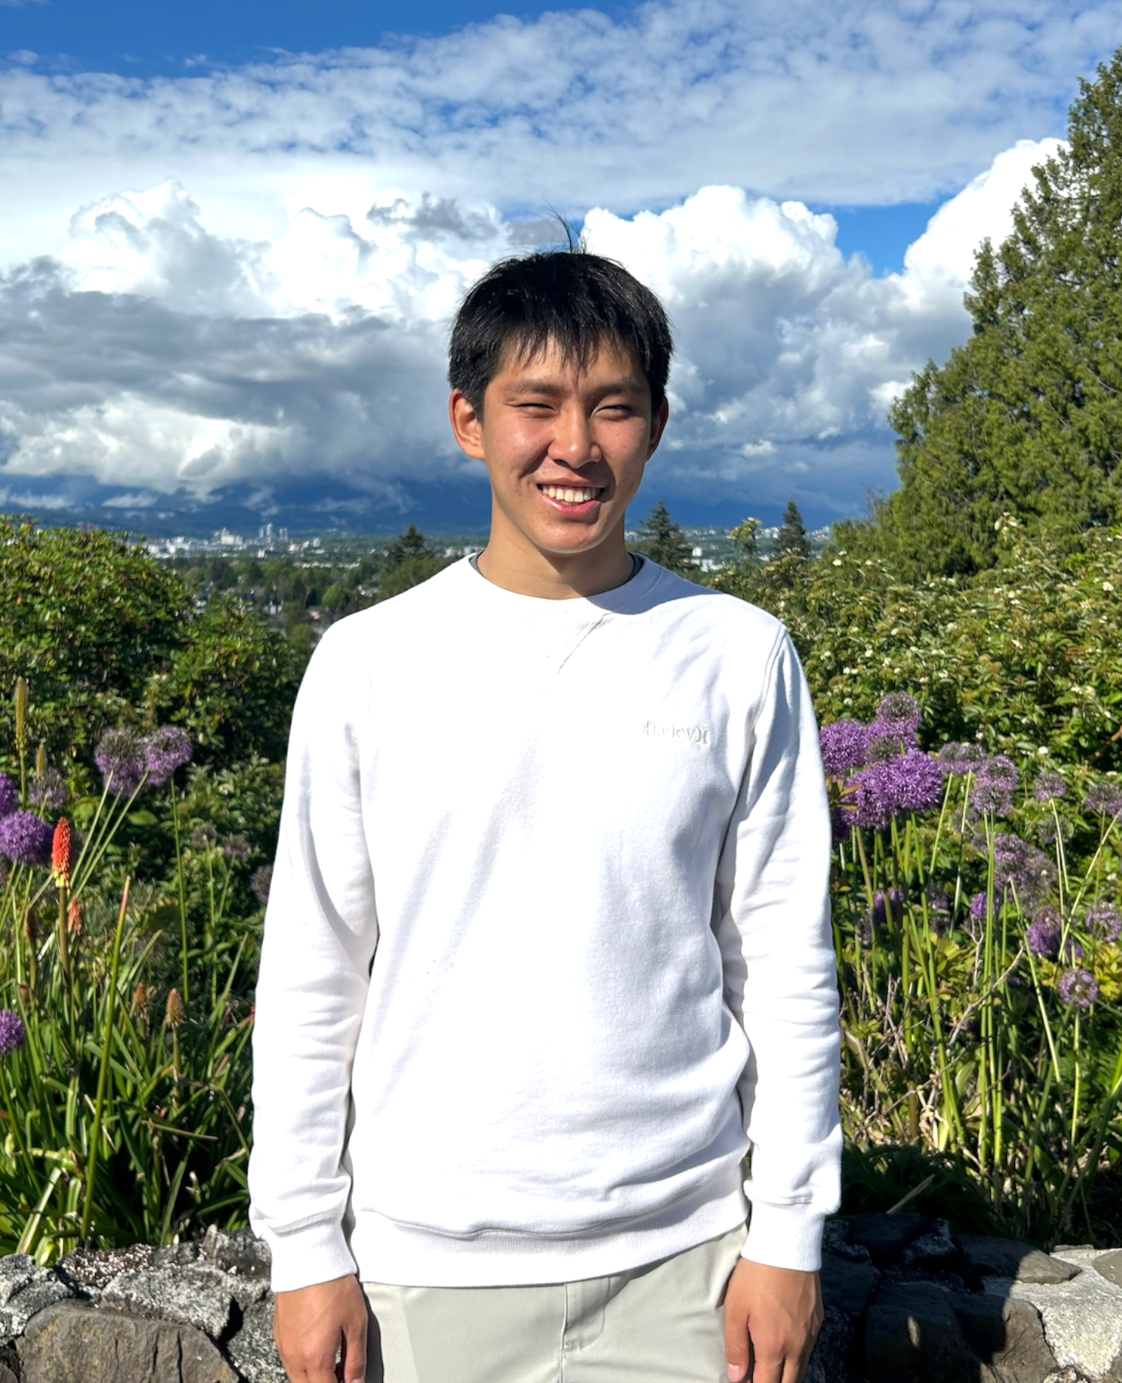
Dustin Miao
Major + graduation year: Computer Science and Biology, 2028
Hey, I'm Dustin! I am a junior majoring in CS with a concentration in ML and a minor in Bio. Outside of academics, I'm a TA for 15-210 and 10-703, and enjoy playing ping pong and going on long walks If you're interested in any of the above, please sign up for a coffee chat!
Email: dustinmi@andrew.cmu.edu. Please email to schedule a coffee chat!

Slide 6
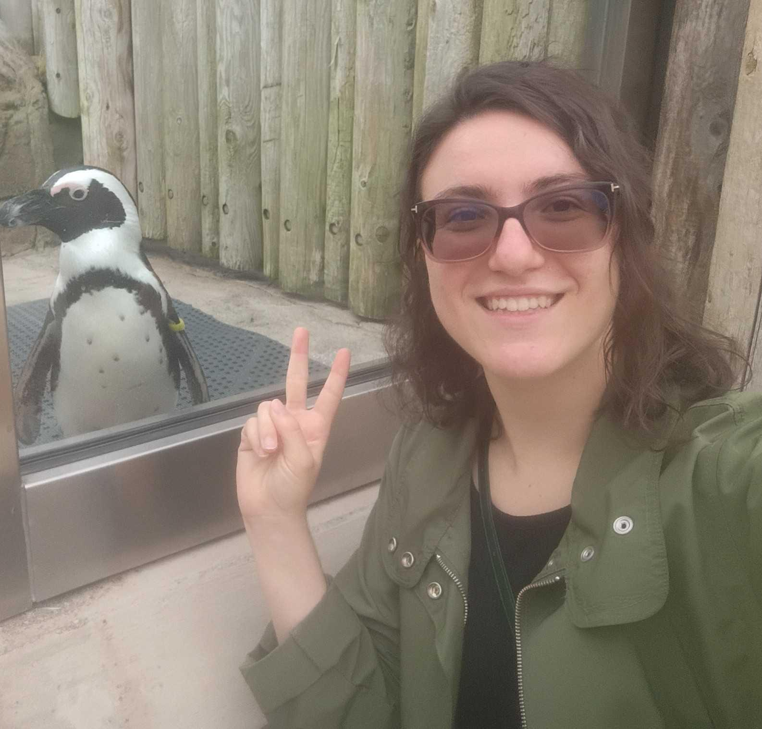
Anna Boeva
Major + graduation year: Computational Biology, 2028
Hey, I’m Anna! I’m a junior studying Computational Biology with a concentration in Machine Learning and a concentration in Algorithms & Complexity. I’m involved in comp bio research, TAing, and various clubs like CMU Star Wars and Photography. I also enjoy reading, playing video games, and dance!
Feel free to contact me here if you have any questions (even if you don’t schedule a coffee chat)!
Email: aboeva@andrew.cmu.edu
Link to schedule a meeting with me!

Slide 7
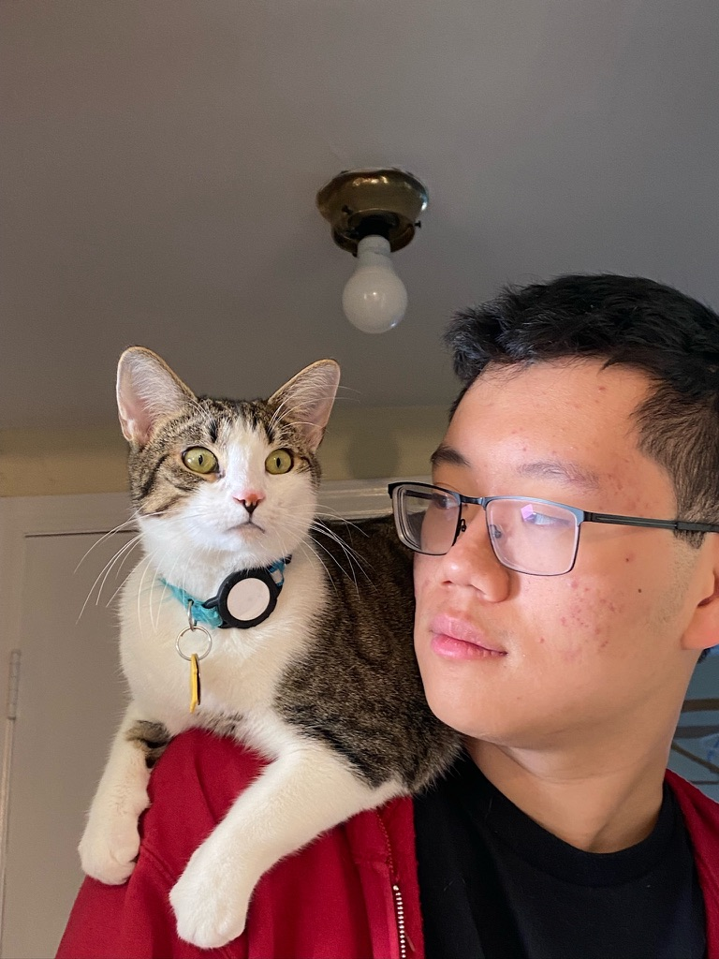
Clayton Yu
Major + graduation year: Computational Biology, 2029
Hello, I’m Clayton, a sophomore in CB! I’m interested in how complex biological systems can be studied through computation. I’m a TA for 02-120 Programming for Scientists, am involved in InterVarsity Christian Fellowship, and am concert manager for Joyful Noise, an cappella group on campus. I also enjoy binging YouTube and playing video games in my spare time!
Feel free to email me with any questions, or schedule a coffee chat at the link below:
Email: claytony@andrew.cmu.edu
Link to schedule a meeting with me!

Slide 8
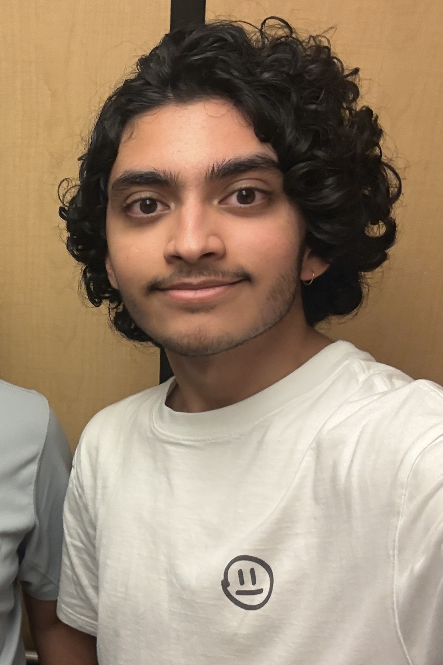
Nihal Josyula
Major + graduation year: Biology + Computational Biology, 2029
Hey, I'm Nihal! I'm a sophomore from Seattle. I'm really interested in foundation models for biology, and most recently I interned with an AI group at the NIH NCI, working on deep learning for medical imaging. On campus I'm involved with ScottyLabs and CASI. Outside of that I really like to ski and hike. I also randomly hop on buses into the city since I like exploring.
I'd love to chat! Schedule a coffee chat at the link below, or just email me.
Email: nihaljos@andrew.cmu.edu
Link to schedule a meeting with me!

Slide 9
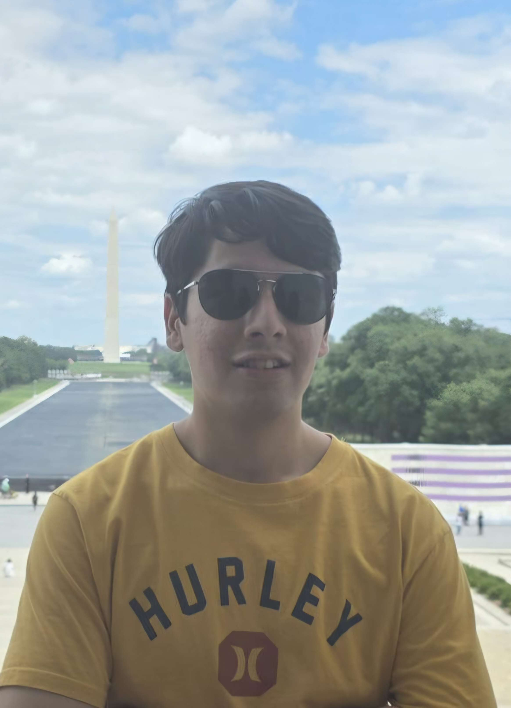
Krit Dass
Major + graduation year: Computer Science and Computational Biology, 2029
Hi, I’m Krit! I’m a sophomore from Orlando studying computer science and computational biology, and I’m especially interested in evolution. I do research in the Pfenning lab, using machine learning to study the evolution of regulatory features across vertebrates. I’m also the lead of the Terrier project in ScottyLabs. In my free time, I enjoy reading, cooking, watching sports (mostly F1 and tennis), and playing badminton and pickleball.
Feel free to email me or schedule a coffee chat!
Email: kdass@andrew.cmu.edu
Link to schedule a meeting with me!

Slide 10
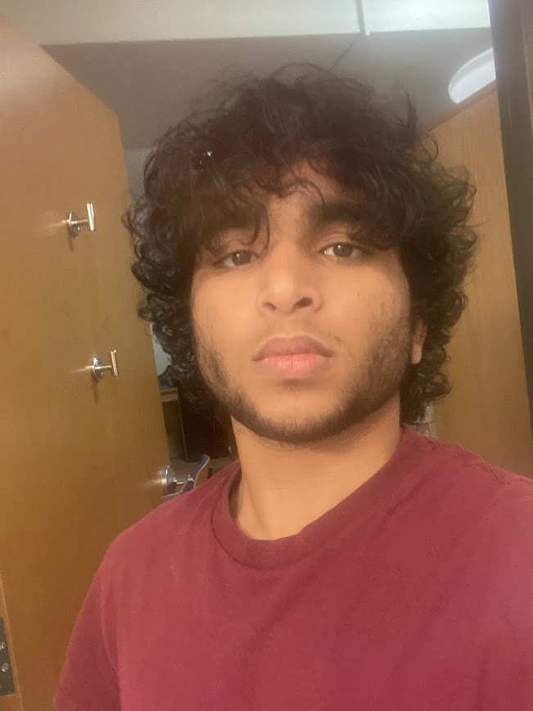
Viraj Kamath
Major + graduation year: Biology + Computational Biology, 2029
Hi, I'm Viraj! I'm a sophomore from Virginia. I'm really interested in computational drug discovery, and most recently I interned with a research group at UPMC working on ovarian cancer suppression. On campus I'm involved with Senate, and in my free time I really like to film videos and read philosophy, as well as watch tv shows (currently watching The Mentalist).
I'd love to chat! Schedule a coffee chat at the link below, or just email me.
Email: virajkam@andrew.cmu.edu
Link to schedule a meeting with me!

